Slide 1
Key elements to fight against climate change

Slide 2
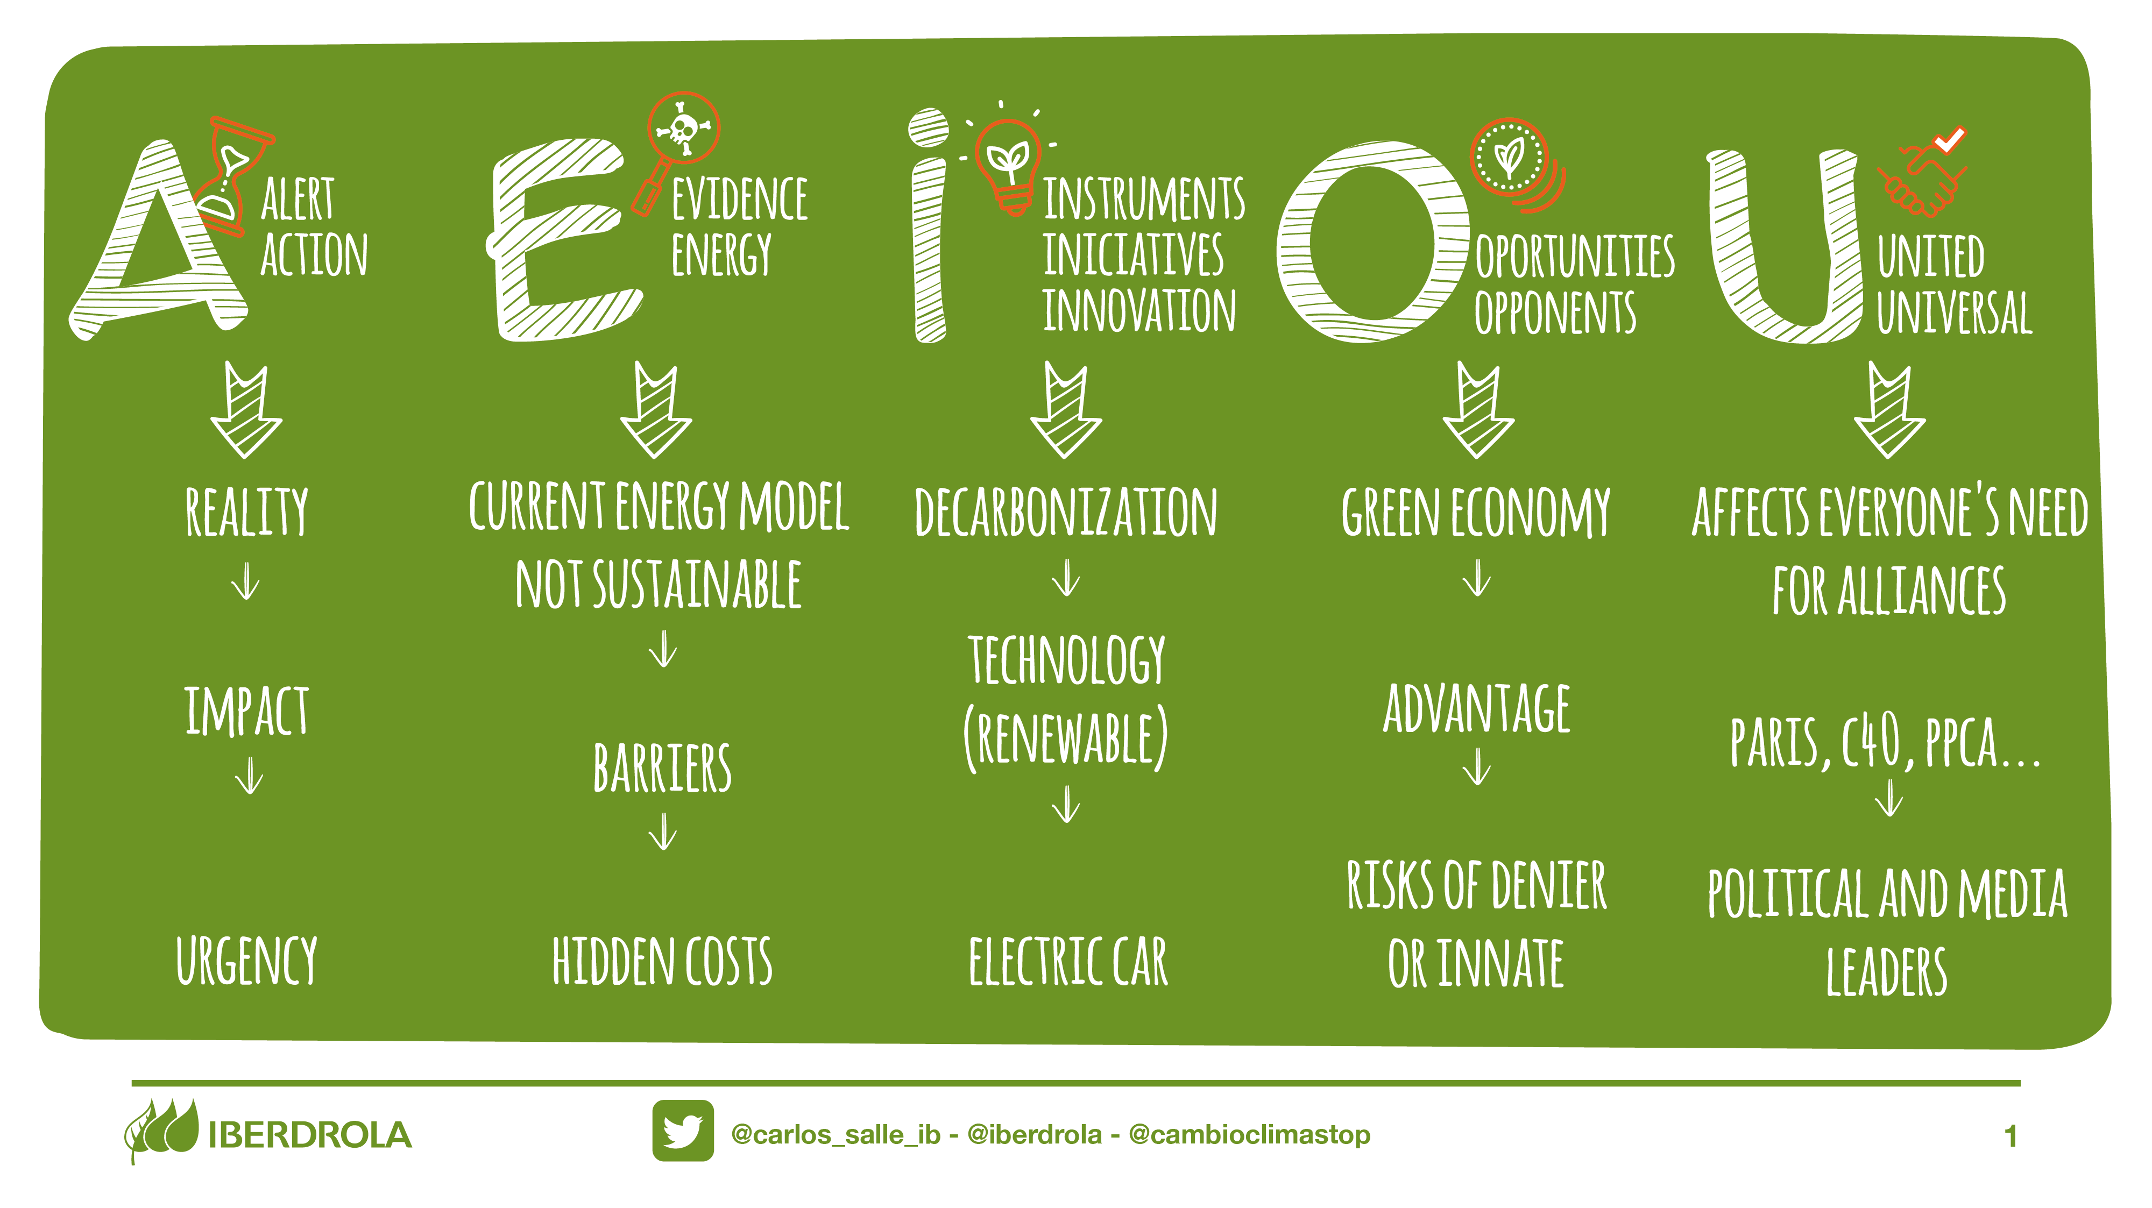
action
evidence
iniciatives
oportunities
united

Slide 3
NEGATIVE
IMPACT ON
GLOBAL GDP
Global
warming
alert
Extreme events
climate refugees
species extinction
and

Slide 4
CO2,
SOx,
deforestation
NOx,
Pm
energy efficiency
evidence
negative impact on
health, extreme weather
events, ...
polluter pays principle
externality

Slide 5
just transition
for vulnerable jobs
decarbonization
energy efficiency
initiatives
• polluter pays •innovation • awareness
renewable energy
use of batteries
electric car
COST
COST
COST
T
T
T

Slide 6
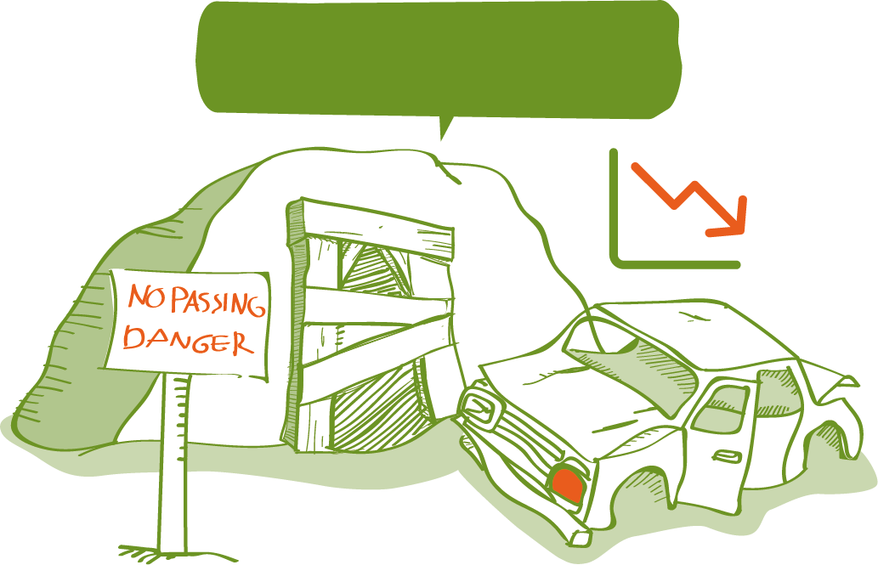
feasible and
competitive
green economy
advantages
TODAY
OPPORTUNITY
Economy
SEGURITY OF SUPPLY
health
Benefits
High risk option
ENVIRONMENTAL
stranted assets
opposition

Slide 7
alliances needed
affects everyone
paris agreement (global) & local actions
NGOs, goverments, regions, cities, companies, universities, citizens...
united
c40
Civilization require energy, but energy use must not destroy civilization
Powering past coal alliance
DISCLOSURE
unfccc
wbcsd
talanoa
CLG
CPLC
we will be toasted, roasted and grilled
There is no Plan B because there is no planet B

Slide 8
#1
INVESTMENTS
ALLIANCES
innovation
Education and Awareness
GOVERNANCE
mitigation
COMMITMENTS
ADAPTATION

Slide 9
THANKS
• Decarbonistaion cost is much lower than the cost of non decarbonising
• Fighting against climate change is an obligation, is feasible and is plenty of opportunities
• Among all we can get it

